Slide 1
Project Option : Ecommerce System
Md Mehedi Hasan
Noakhali Science and Technology University
mehedihasan.nstu.ice@gmail.com

Slide 2
Feature:
Admin Interface
The admin has a dedicated interface to manage customer accounts,products and sells information
Admin approval is required for new customer registration
User Registration and Interface
Visitors can register using email
Customer Information
Name,Email,Address
Product list
Add product in different category
Add to Cart System

Slide 3
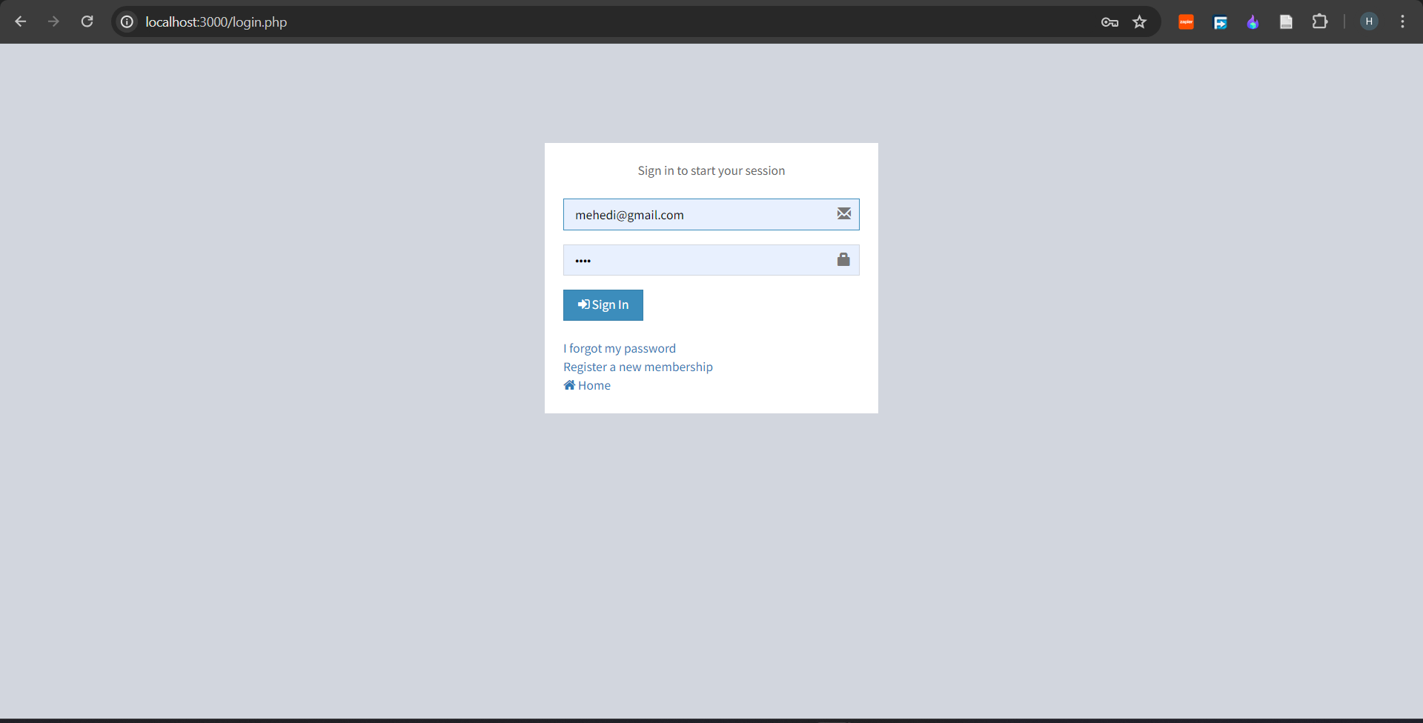
Admin Interface:
Login:

Slide 4
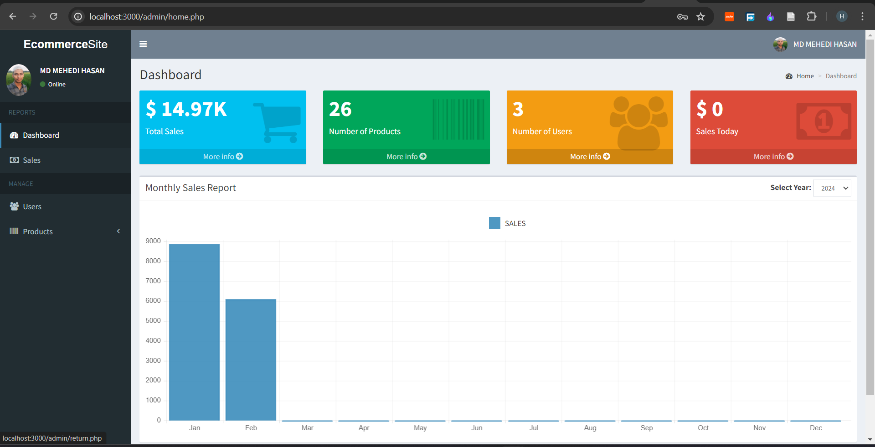
Admin Dashboard

Slide 5
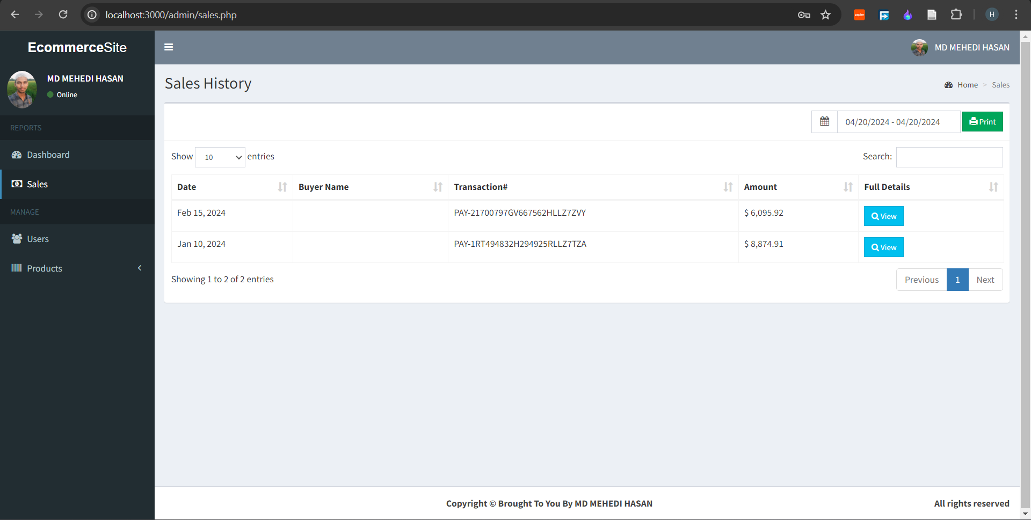
sells history

Slide 6
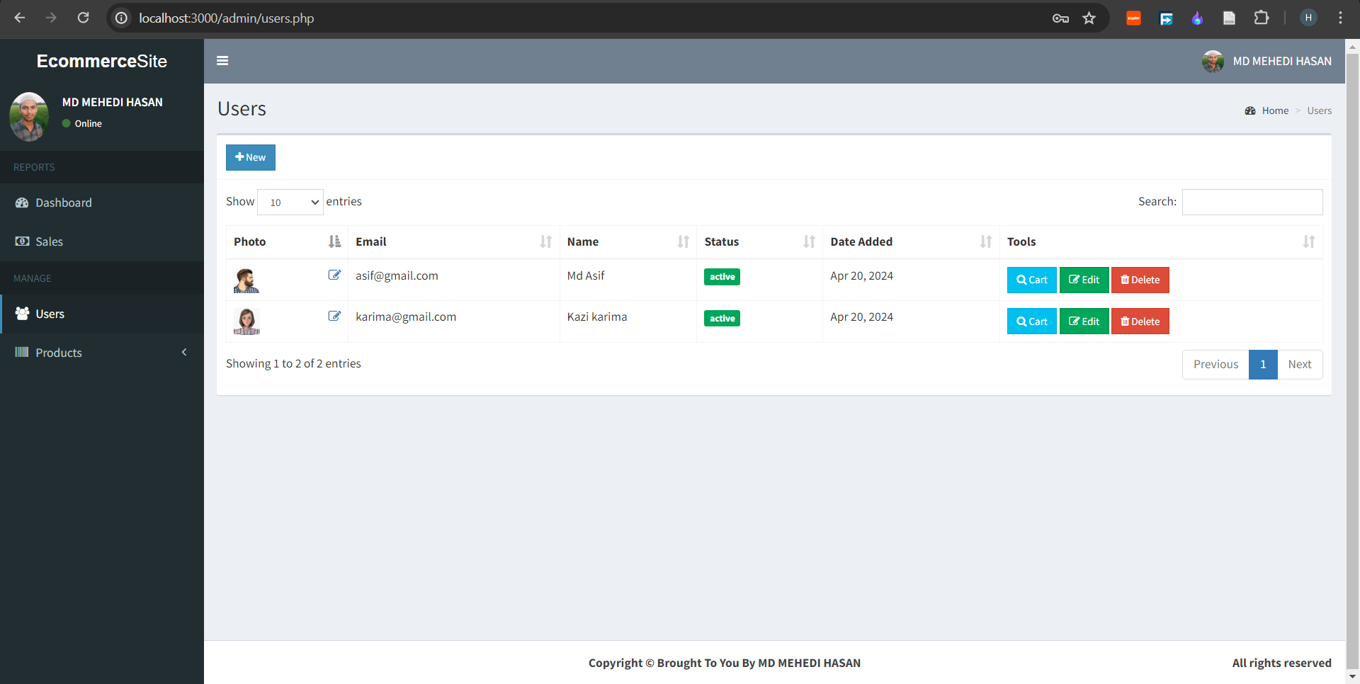
Users Details:

Slide 7
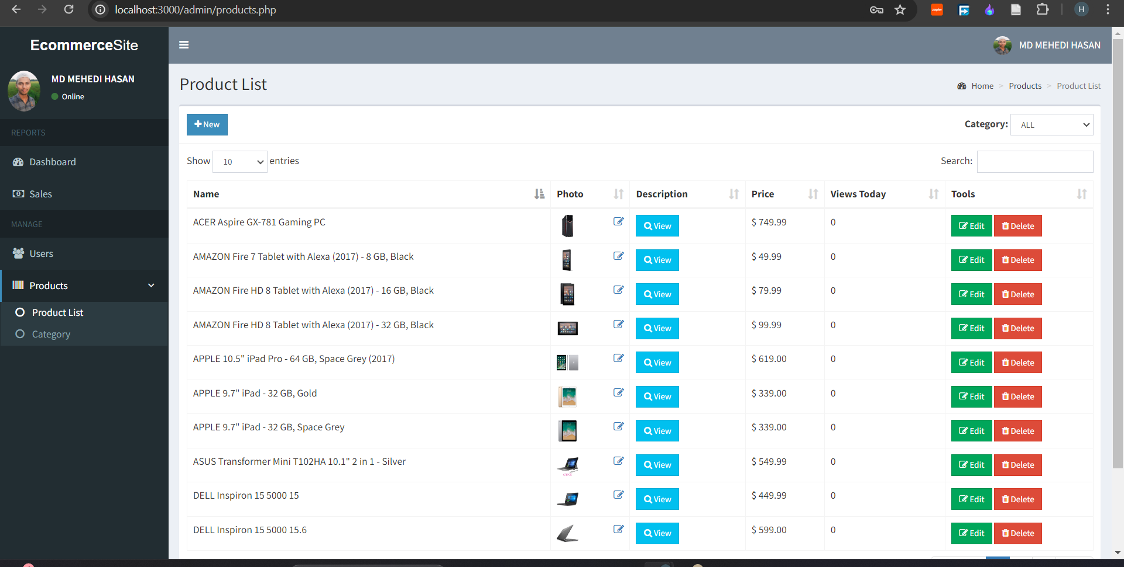
Product details:

Slide 8
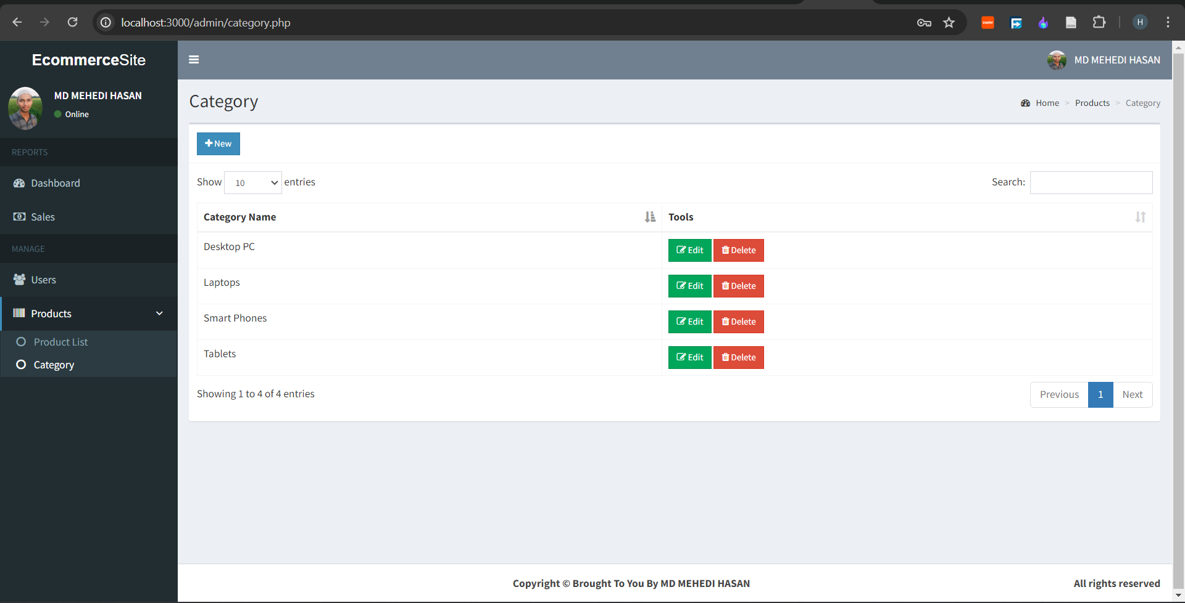
Product category:

Slide 9
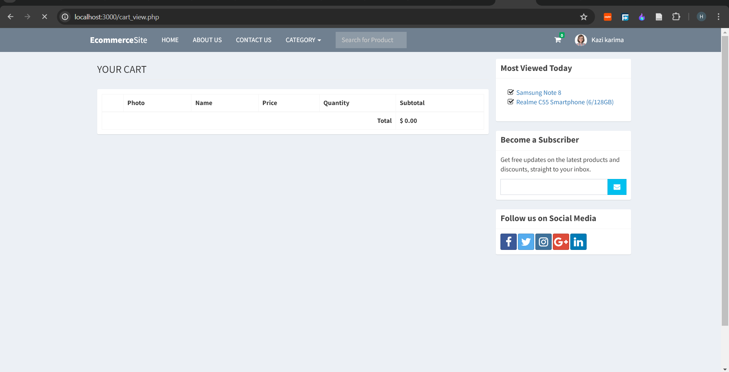
User Interface:

Slide 10
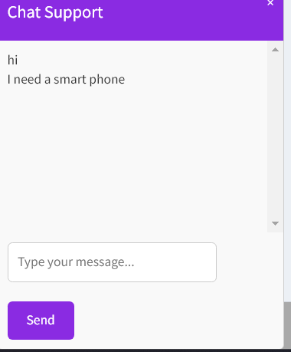
Chat Box:

Slide 11
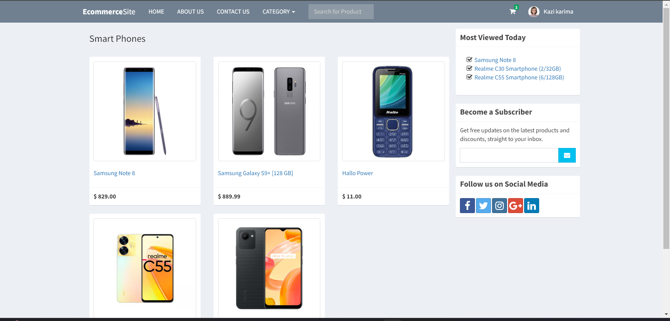
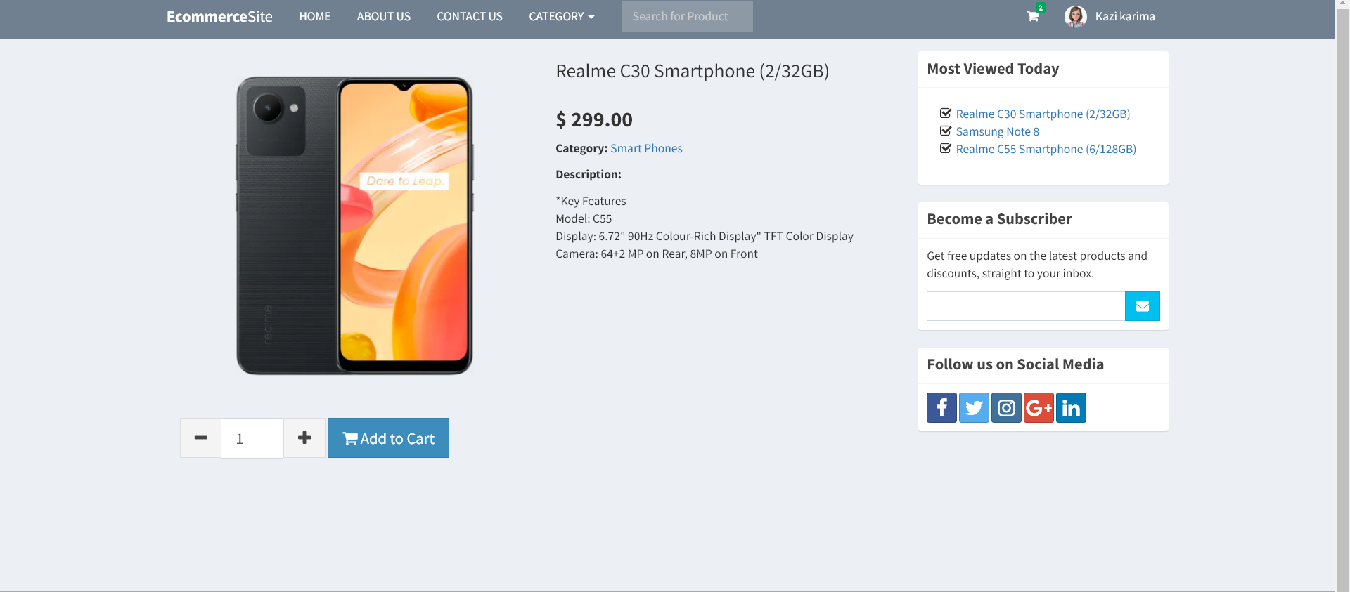
Product:

Slide 12
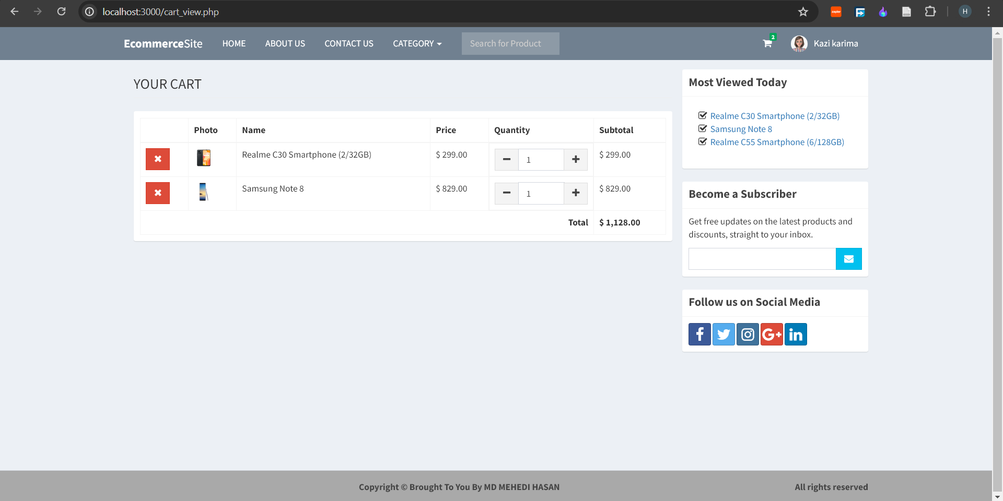
User Cart:

Slide 13
Thank You
for
Your kind attention

